Slide 1
Data Visualization
HTML, CSS, SVG, (& JavaScript)
Original Slides by Dr. David Koop

Slide 2
Resources
https://jsfiddle.net/
HTML Tutorials: https://www.htmldog.com/guides/
Chrome Dev Tools and d3: http://blog.nextgenetics.net/?e=21
Scot Murray’s d3 tutorials: https://alignedleft.com/tutorials/d3

Slide 3
Hyper Text Markup Language (HTML)
Markup languages allow users to encode the semantics of text
Tags define the boundaries of the structures of the content
Tags are enclosed in angle brackets (e.g. <html>)
Most of the time, you have a start and end tag
End tags are just like start tags except that they have forward slash after the open bracket (e.g. </html>)
Tags may be nested but not mismatched
<p>A <strong><em>very</em></strong> cool example</p>
<p>A <strong>very <em>cool</strong></em> example</p>
What about <img src=“mypicture.png” alt=“My Image”>?

Slide 4
HTML Elements and Attributes
Tags denote elements of the content (e.g. sections, paragraphs, images)
Each element may have attributes which define other information about the element
An attribute has a key and value (key=“value”)
e.g. <img src=“mypicture.png” alt=“My Image”>
Many different elements available
Common: headers (h1, …, h6), paragraph (p), lists (ul, ol, li), emphasis (em, strong), link (a), spans & divisions (span, div)
Lots more (e.g. abbr): see MDN Documentation
Many different attributes available
See MDN Documentation: note that some are legacy due to CSS

Slide 5
HTML Element Structure & Naming
Elements structure a document
Document Object Model (DOM)
We can visualize this information
More importantly, we can navigate this tree
Identifying and Classifying elements: id and class attributes
id identifies a single element—use for a unique case
class may identify multiple elements—use for common cases
Each element may have multiple classes, separate by spaces
Use normal identifiers: don’t start the name with a number

Slide 6
Other HTML Trivia
<, >, &, and " are special characters, escape with &lt;, &gt;, &amp;, and &quot; (note the semi-colon)
Comments are enclosed by <!-- and —>
<!-- This is a comment -->
HTML Documents begin with a DOCTYPE declaration
For HTML5, this is easier <!DOCTYPE html>
meta tag: <meta charset="UTF-8"/>
HTML has audio and video tags, math equation support, and more

Slide 7
Basic HTML File
<!DOCTYPE html>
<html>
<head>
<title>A Basic Web Page</title>
</head>
<body>
<h1>My Wicked Awesome Web Page</h1>
<p><em>This is <strong>cool</strong>. What about
<u><strong>this?</strong></u></em></p>
<img src="patriots.jpg"/>
</body>
</html>

Slide 8
How to write HTML
Use a standard text editor
Use a web site like jsfiddle, jsbox, etc.
Use an IDE like WebStorm

Slide 9
Cascading Style Sheets (CSS)
Separate from content, just specifies how to style the content
Style information can appear in three places:
External file
In a style element at the beginning of the HTML file
In a specific element in the body of a document (least preferable)
Why Cascading?
Don’t want to have to specify everything over and over
Often want to use the same characteristics in a region of the DOM
Use inheritance: properties that apply to children cascade down

Slide 10
CSS Selectors
How do we specify what part(s) of the page we want to style?
The element types themselves (the HTML tag)
strong { color: red; }
Classes of elements (ties to HTML class attribute)
.cool { color: blue; }
A specific element (ties to HTML id attribute)
#main-section { color: green; }
Relationships
Descendant: p em { color: yellow; }
- Child: p
> em { color: orange; }
Pseudo-classes: a:hover { color: purple; }

Slide 11
Other CSS Bits
Comments: /* This is a comment in CSS */
Grouping Selectors: p, li { font-size: 12pt; }
Multiple Classes: .cool.temp { color: blue; }
Colors:
Names (Level 1, 2, & 3): red, orange, antiquewhite
Dash notation (3- & 6-character): #fff, #00ff00
Integer or % RGB and HSL Functions: rgb( 255, 0, 0), rgb(50%, 50%, 0%), hsl(120, 100% 50%)
Also background-color
Watch out for multiple rules (look at how a web browser parses)
Again, much more documentation at MDN

Slide 12
Sample CSS
body {
font-face: sans-serif; font-size: 12pt;
}
em { color: green; } em u { color: red; }
em > strong { color: blue; } img { border: 4px solid red; }
What colors are displayed for this HTML (with the above stylesheet)?
- <em>This is <strong>cool</strong>. What about
<u><strong>this?</strong></u></em>

Slide 13
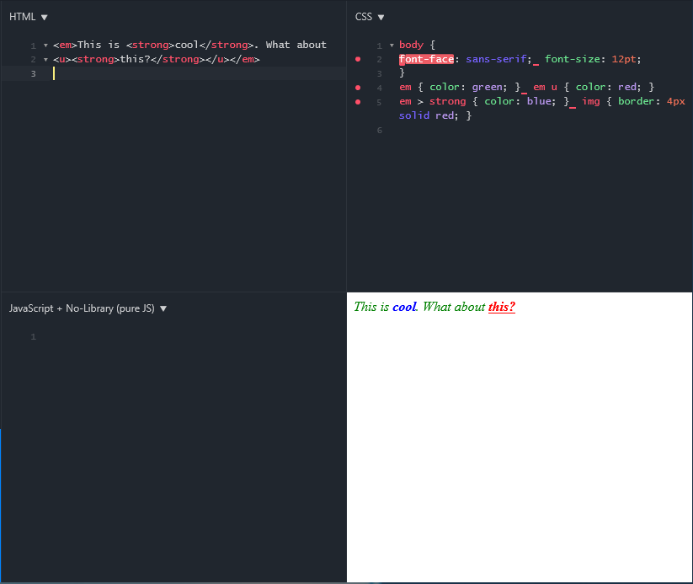
Example with jsfiddle

Slide 14
How to add CSS to HTML
External: a separate file via a link element (in the <head> section):
<link rel=“stylesheet” href=“styles.css”>
Embedded: in the header:
<style type=“text/css”> … </style>
Inline: for a specific element: (Discouraged!)
<p style=“font-weight: bold;”>Some text</p>

Slide 15


Scalable Vector Graphics (SVG)
Vector graphics vs. Raster graphics
Drawing commands versus a grid of pixels
Why vector graphics?
Raster
Vector

Slide 16
SVG Background
Another markup language:
- Describe the shapes and paths by their endpoints, characteristics
SVG can be embedded into HTML5 documents!
Pixel Coordinates: Top-left origin
(0,0) (width,0)
(width,height)

Slide 17
SVG Elements
Drawing primitives:
Lines, Circles, Rects, Ellipses, Text, Polylines, Paths
Work by specifying information about how to draw the shape
Lots more: see MDN Documentation
Ordering/Stacking:
SVG Elements are drawn in the order they are specified

Slide 18
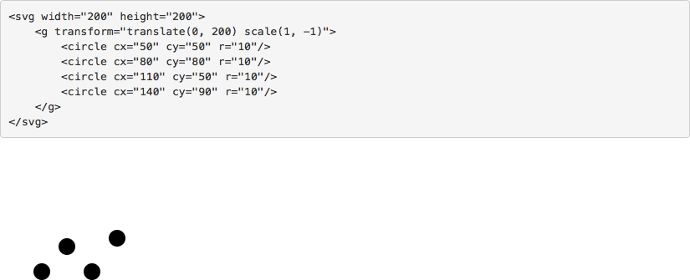
SVG Grouping
Very powerful, useful for animations and transformations
<g> <circle …/> <circle … /> <circle … /></g>
Can add transforms to the group:
- <g transform="translate(0, 50) scale(1, -1)”> … </g>
[SVG Example, Scheidegger, 2015]

Slide 19
SVG Example
<svg id="mysvg" width="400" height="300">
<circle cx="50" cy="50" r="50"
style="fill:green; stroke:black; stroke-width:4px"/>
<rect x="150" y="150" width="50" height="20" style="fill:red; stroke: blue; stroke-width: 2px;"/>
<path d="M 200 10 L 300 10 L 300 50 Z"
style="fill: none; stroke: red; stroke-width:3px;”/>
</svg>
Note that the style is separate…
Paths are raw drawing commands (ever see Logo?)
What does this look like?

Slide 20
SVG Styles
Can specify styles via CSS, too
…
<style type="text/css">
circle { fill: green; stroke: black; stroke-width: 4px; }
.normal { fill: red; stroke: blue; stroke-width: 2px; }
#p1 { fill: none; stroke: red; stroke-width: 3px; }
</style>
…
<svg id="mysvg" width="400" height="300">
<circle cx="50" cy="50" r="50"/>
<rect class="normal" x="150" y="150" width="50" height="20"/>
<path id="p1" d="M 200 10 L 300 10 L 300 50 Z"/>
</svg>
…

Slide 21
JavaScript in one slide
Interpreted and Dynamically-typed Programming Language
Statements end with semi-colons, normal blocking
Variables: var a = 0;
Operators: +, -, *, /, [ ]
Control Statements: if, else
Loops: for, while, do-while
Arrays: var a = [1,2,3]; a[99] = 100; console.log(a.length);
Functions: function myFunction(a,b) { return a + b; }
Objects: var obj; obj.x = 3; obj.y = 5;
- Protoypes for instance functions
Comments are /* Comment */ or // Single-line Comment

Slide 22
JavaScript: Interacting with the DOM
window: global namespace
document
document.getElementById(…)

Slide 23
JavaScipt and SVG
SVG can be navigated just like the DOM
We can create SVG elements dynamically using JavaScript!
Example:
function addEltToSVG(svg, name, attrs) { var element = document.createElementNS(
"http://www.w3.org/2000/svg", name); if (attrs === undefined) attrs = {};
for (var key in attrs) { element.setAttributeNS(null, key, attrs[key]);
}
svg.appendChild(element);
}
mysvg = document.getElementById("mysvg"); addEltToSVG(mysvg, "rect", {"x": 50, "y": 50,
"width": 40,"height": 40,
"fill": "blue"});

Slide 24
Tools
Text Editor
Chrome DevTools
MDN Documentation
Web Environments (jsfiddle, jsbox)
IDEs (e.g. WebStorm)

